Slide 1
The effects of mangrove restoration on fish stocks and marine biodiversity in Indonesia
Sophie Wulfing

Slide 2
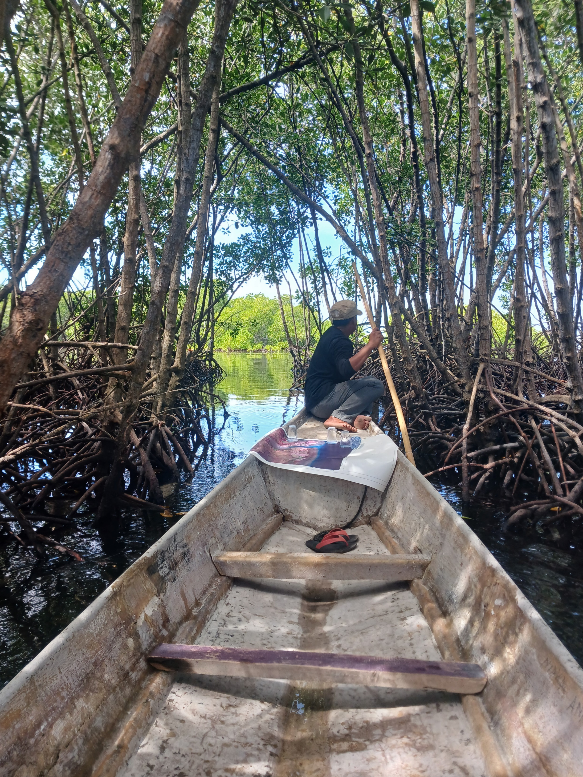
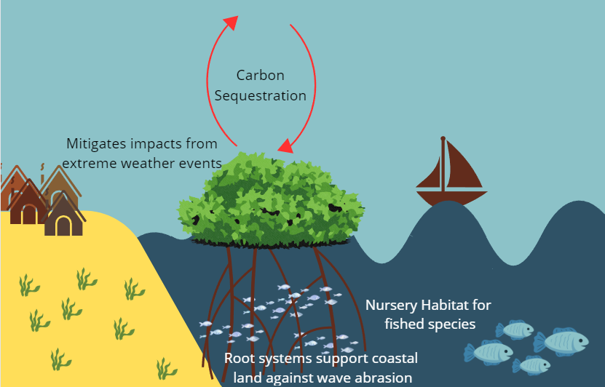
Research background – Mangroves!
Notes:
Def: forests in coastal swamps that are typically flooded at hight tide. Known for incredible root systems
Higher per hectare carbon storage than terrestrial forests
About 90% of all tropic fish species spend somepoint of their lives in mangroves – 55% of catch in Indonesia
Climate change growing issue, coastal communities are the most vulnerable
210 million people worldwide live within 10 km mangroves

Slide 3
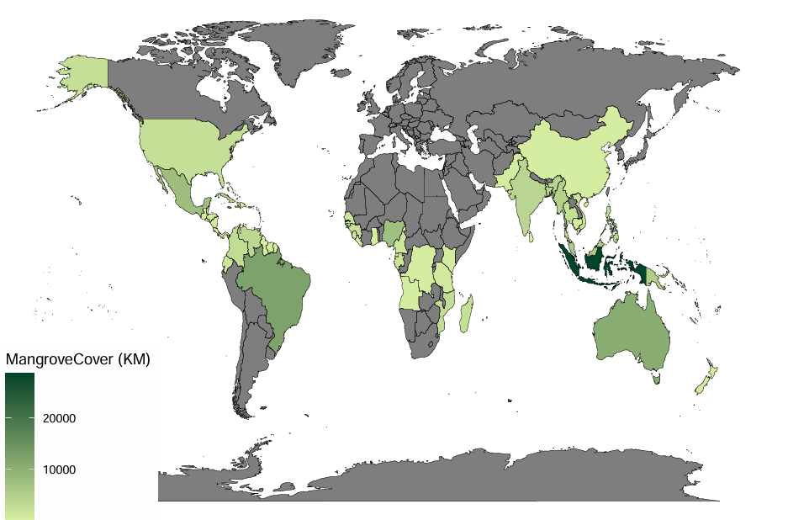
Mangroves in Indonesia
Notes:
Indonesia is home to the highest area of mangroves in the world, but Ministry of Forestry reported in 2007 that around 69% of mangroves were in damaged condition in the country
As a response, Indonesian government is restoring 600,000 hectares of mangroves – most ambitious in the world

Slide 4
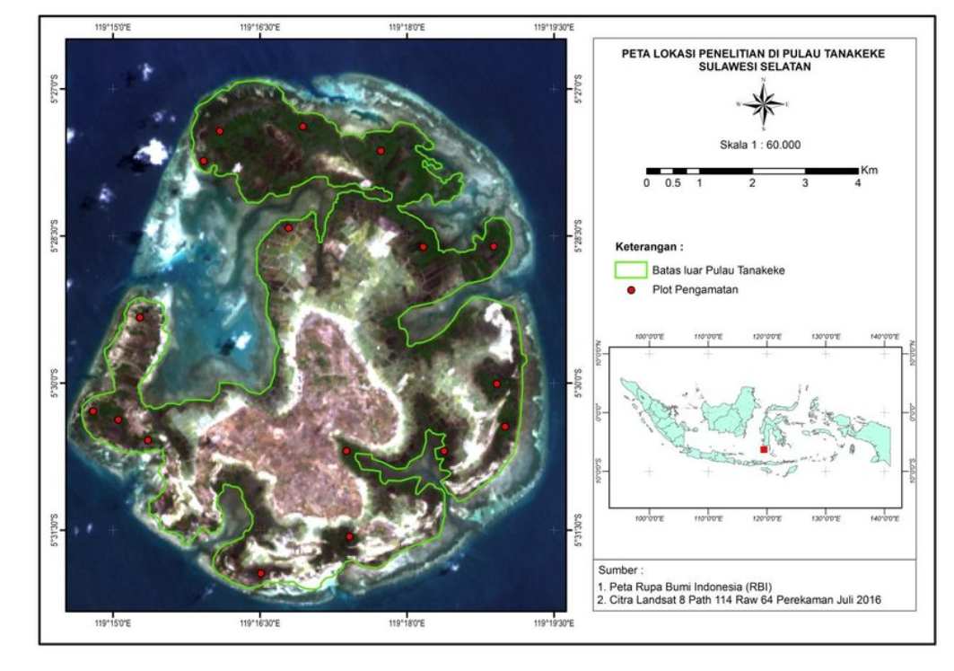
Pulau Tanakeke
Photo: Blue Forests Foundation
Notes:
6 Desas Heavy mangrove cover
70% historical cover destroyed in the 90’s. Mostly for shrimp ponds which were only successful for a few years

Slide 5
Objectives
Determine the effect of mangrove restoration on the fishery production on Pulau Tanakeke, Takalar Regency, South Sulawesi Province, Indonesia.
Uncover what aspects of mangrove cover is most beneficial to juvenile fish populations (i.e. reductions in water temperature, shade, or increased plant biomass).

Slide 6
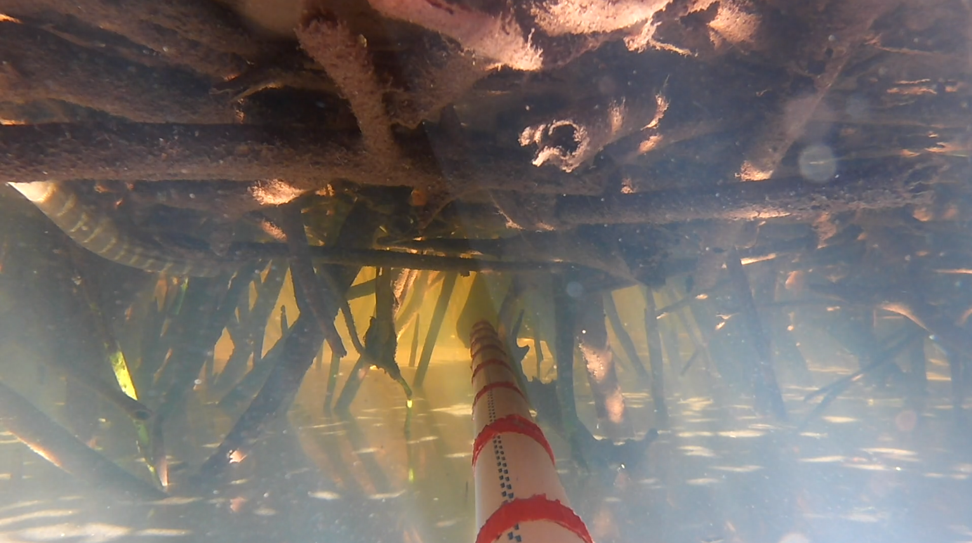
Methods
URUVS – Unbaited Remote Underwater Video
Non-invasive
Easy implementation
Temperature and light loggers
Notes:
Don’t need to take any samples
Easy in the field but downside: long processing times
Fish identification difficult

Slide 7
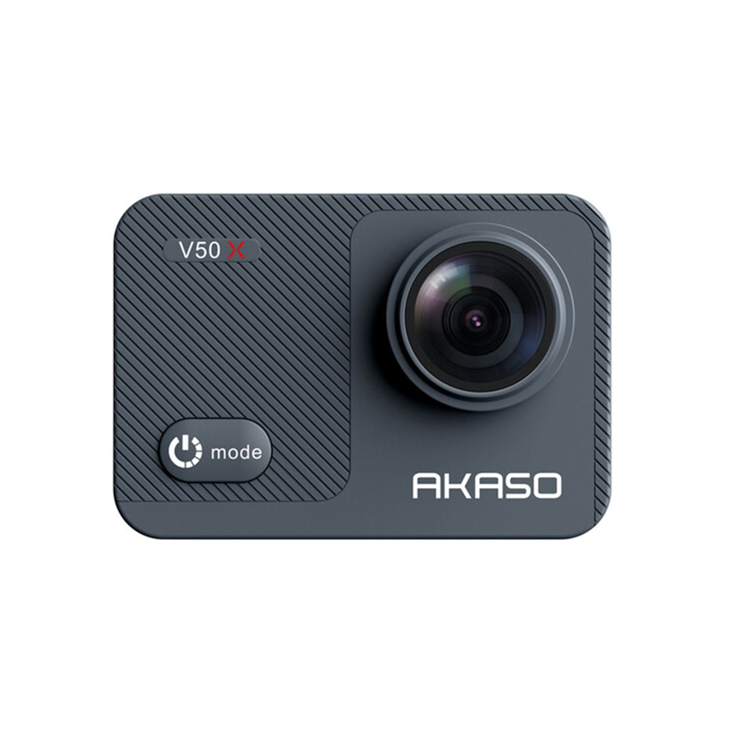
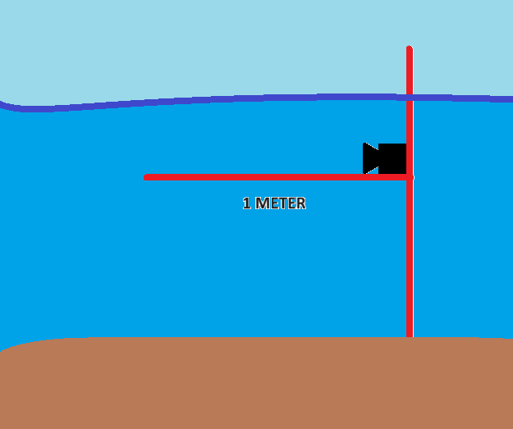
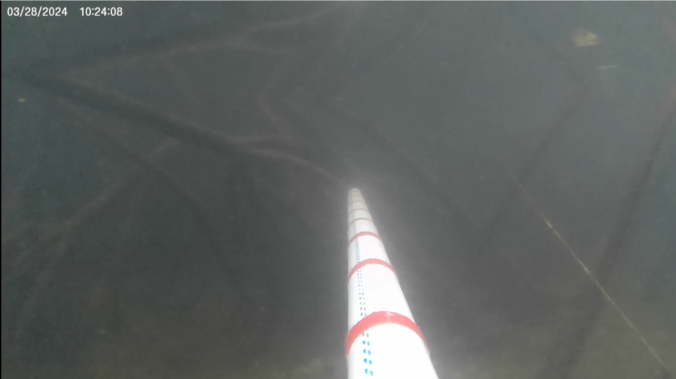
Set-up

Slide 8
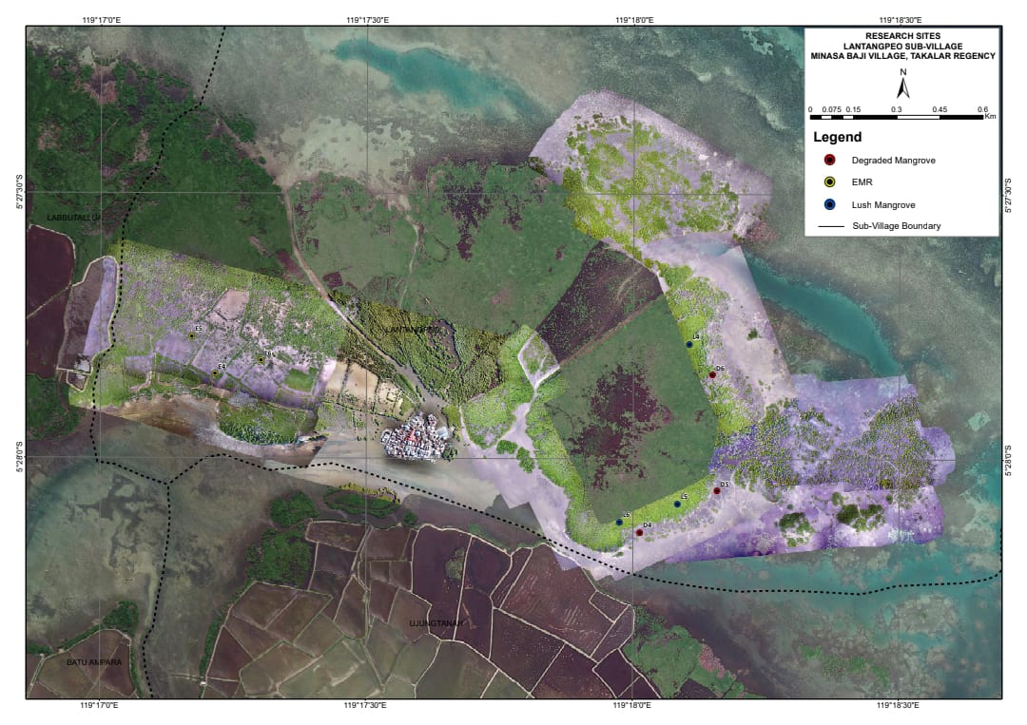
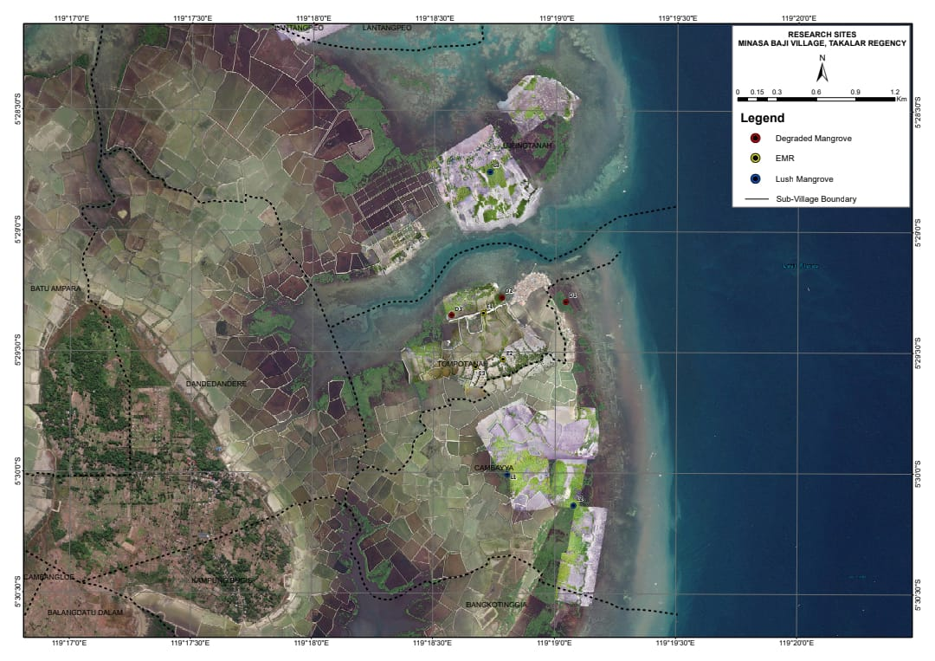
Sites
Latangpeo
Tompotana
EMR
NATURAL
DESTROYED

Slide 9
So far:
4 months of data collection (February - May)
18 videos per month
2 Desa – Tompotana and Lantangpeo
3 sites – destroyed mangroves (D)
3 sites – natural mangroves (L)
3 sites – restored mangroves (E)
All videos been watched (except half of April)
3 Temperature loggers in Lantangpeo (one in each of the mangrove types)
~26 species of fish, 2 species of snakes, at least 2 species of crabs

Slide 10
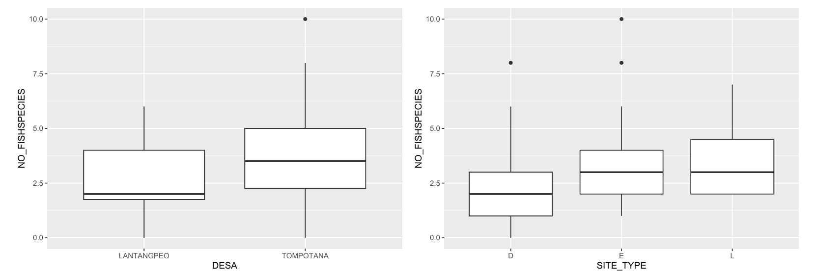
Preliminary Results – Total number of Species

Slide 11
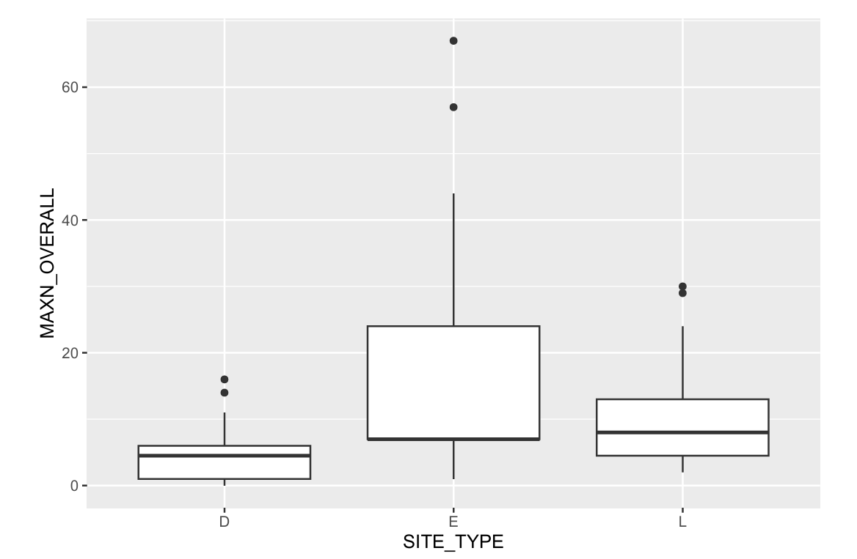
Preliminary Results – Total MaxN

Slide 12
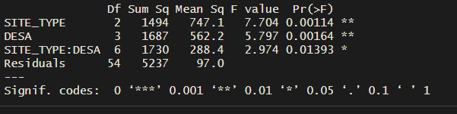
anova
Two-way ANOVA shows that both Mangrove type and Desa have a significant effect on the overall MaxN of the sites. These variables are also likely interacting, meaning that restoration in Latangpeo may have different effects than restorationin Tompotana

Slide 13
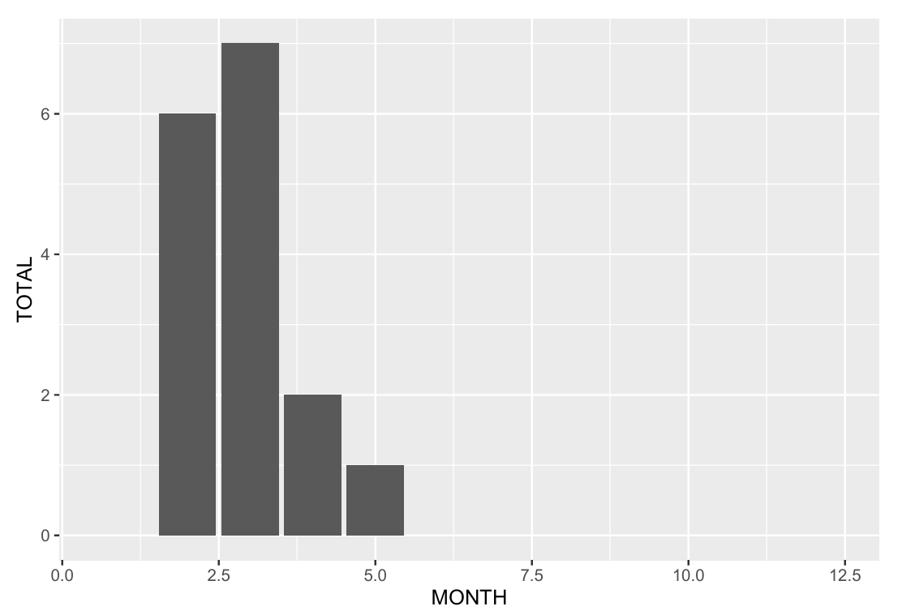
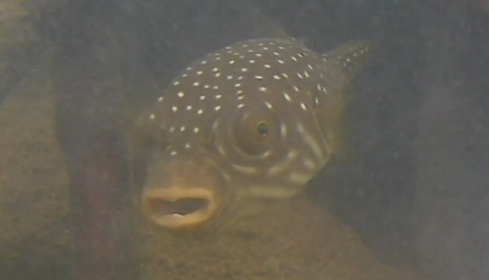
Temporal trends: Ikan Buntal

Slide 14
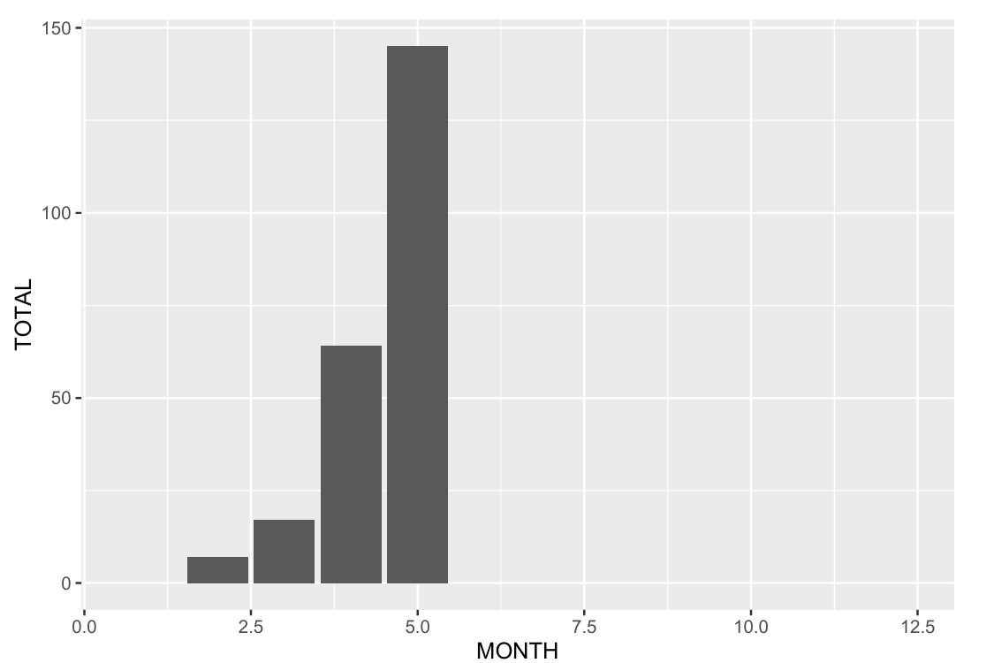
Temporal Trends: Cardinal Fish

Slide 15
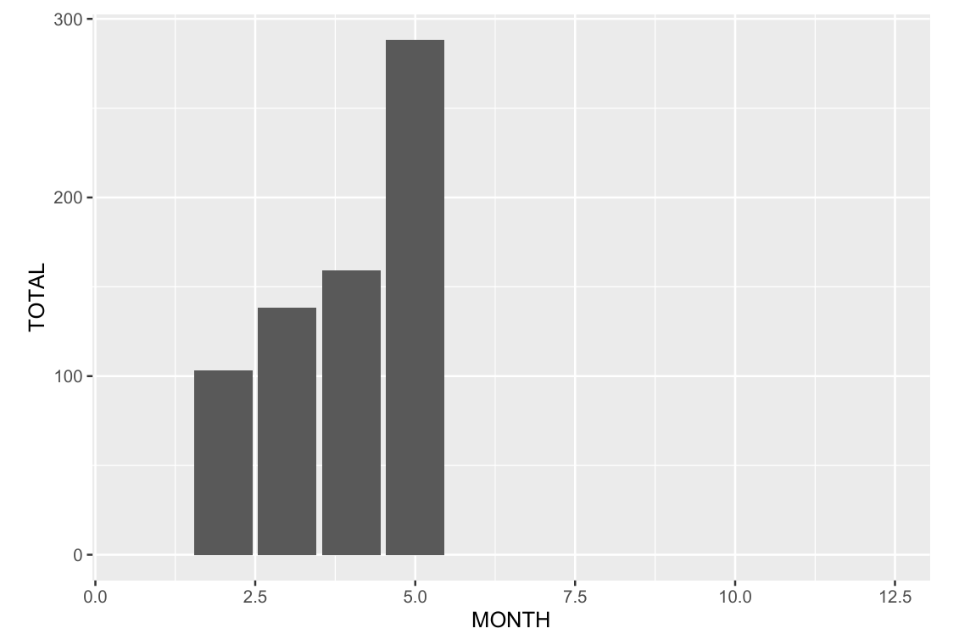
Temporal trends: Total Biodiversity

Slide 16
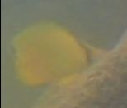

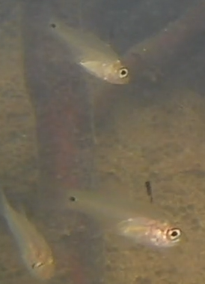
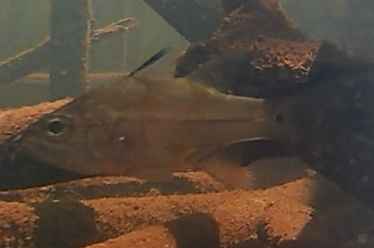
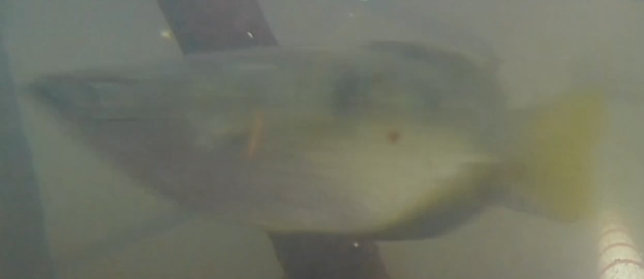
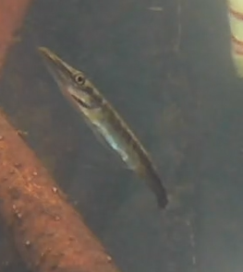
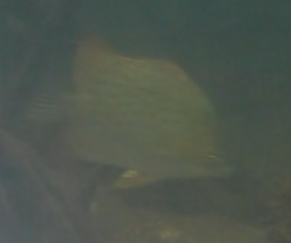
Species found
Reticulated Pufferfish -
Arothron reticularis
Yellow Longnose Butterfly Fish -
Forcipiger flavissimus
Cardinal fish – multiple species
Banded Archerfish - Toxotes jaculatrix
Spotted Butteryfly fish –
Scatophagus argus
baby barracuda - Sphyraenidae

Slide 17
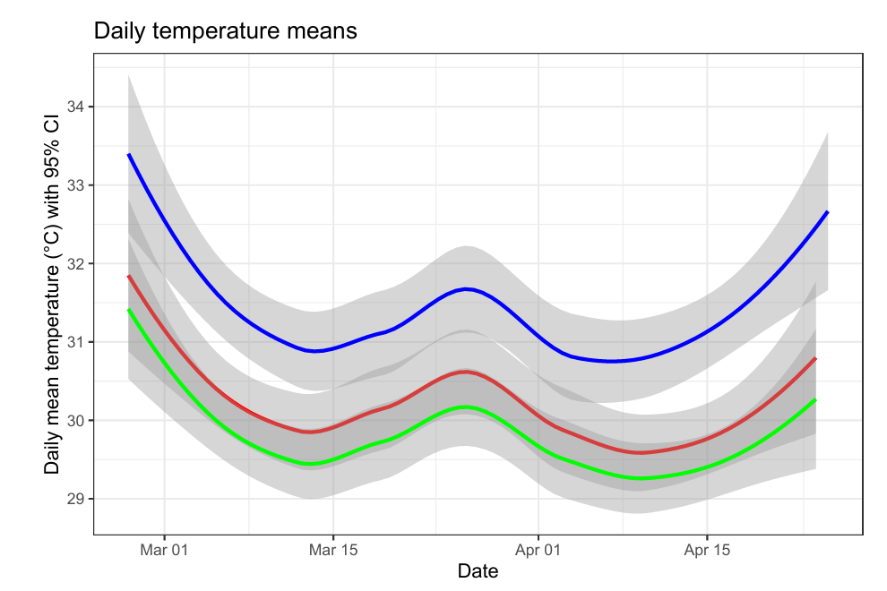
HOBO Results

Slide 18
Future Analyses
Temporal Trends
Shannon’s diversity Index
Principal Component Analysis
Community Structures
Connect data to canopy, weather, tides, and temperature

Slide 19
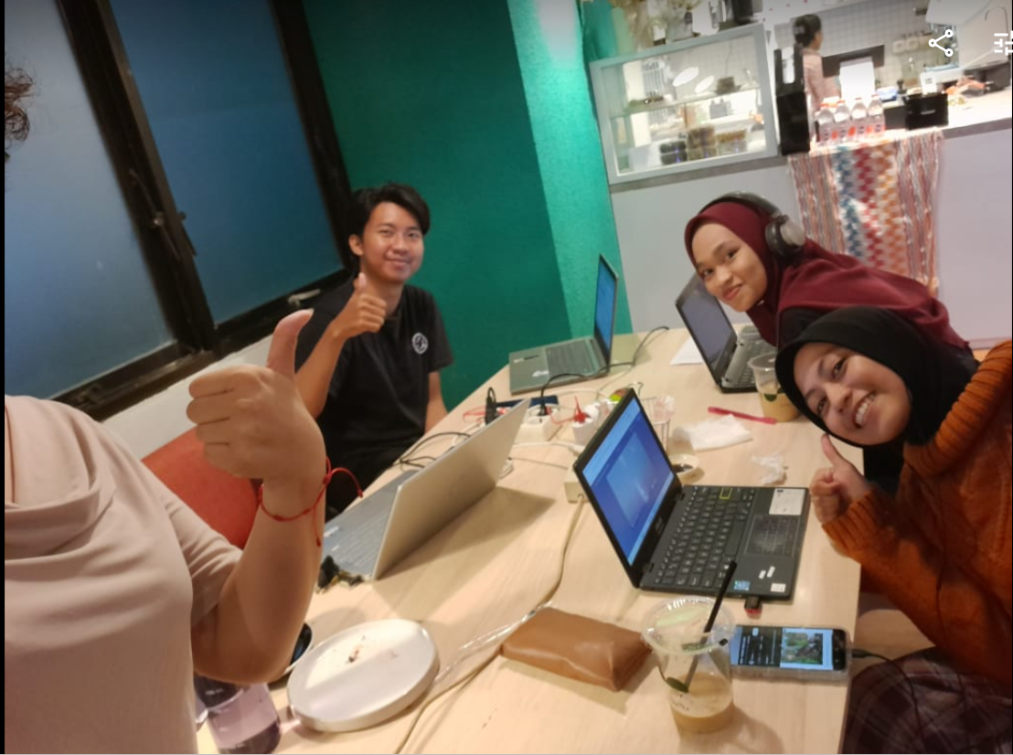

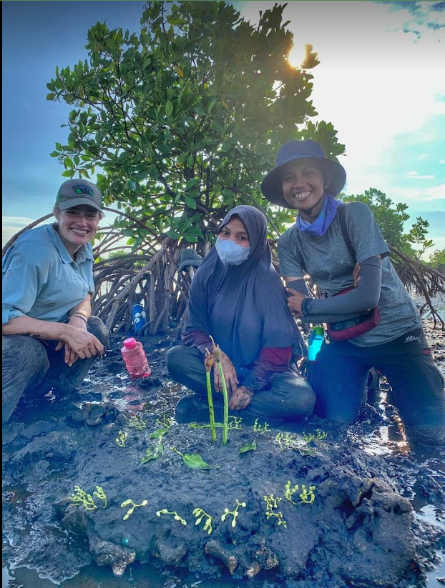
Collaboration activities/ Big picture goals
Monitoring
UNHAS Students
Learning R
Use data for theses
Possible engagement project
Present to Tanakeke
Publishing goals – PLOSONE or PeerJ
Help YHB show the benefits of their work to potential funders
Notes:
Prof Rohani – logistical advice and found students for me

Slide 20

Check out Blue Forests!!!
https://blue-forests.org/id/
Instagram: @blueforests

